Slide 1
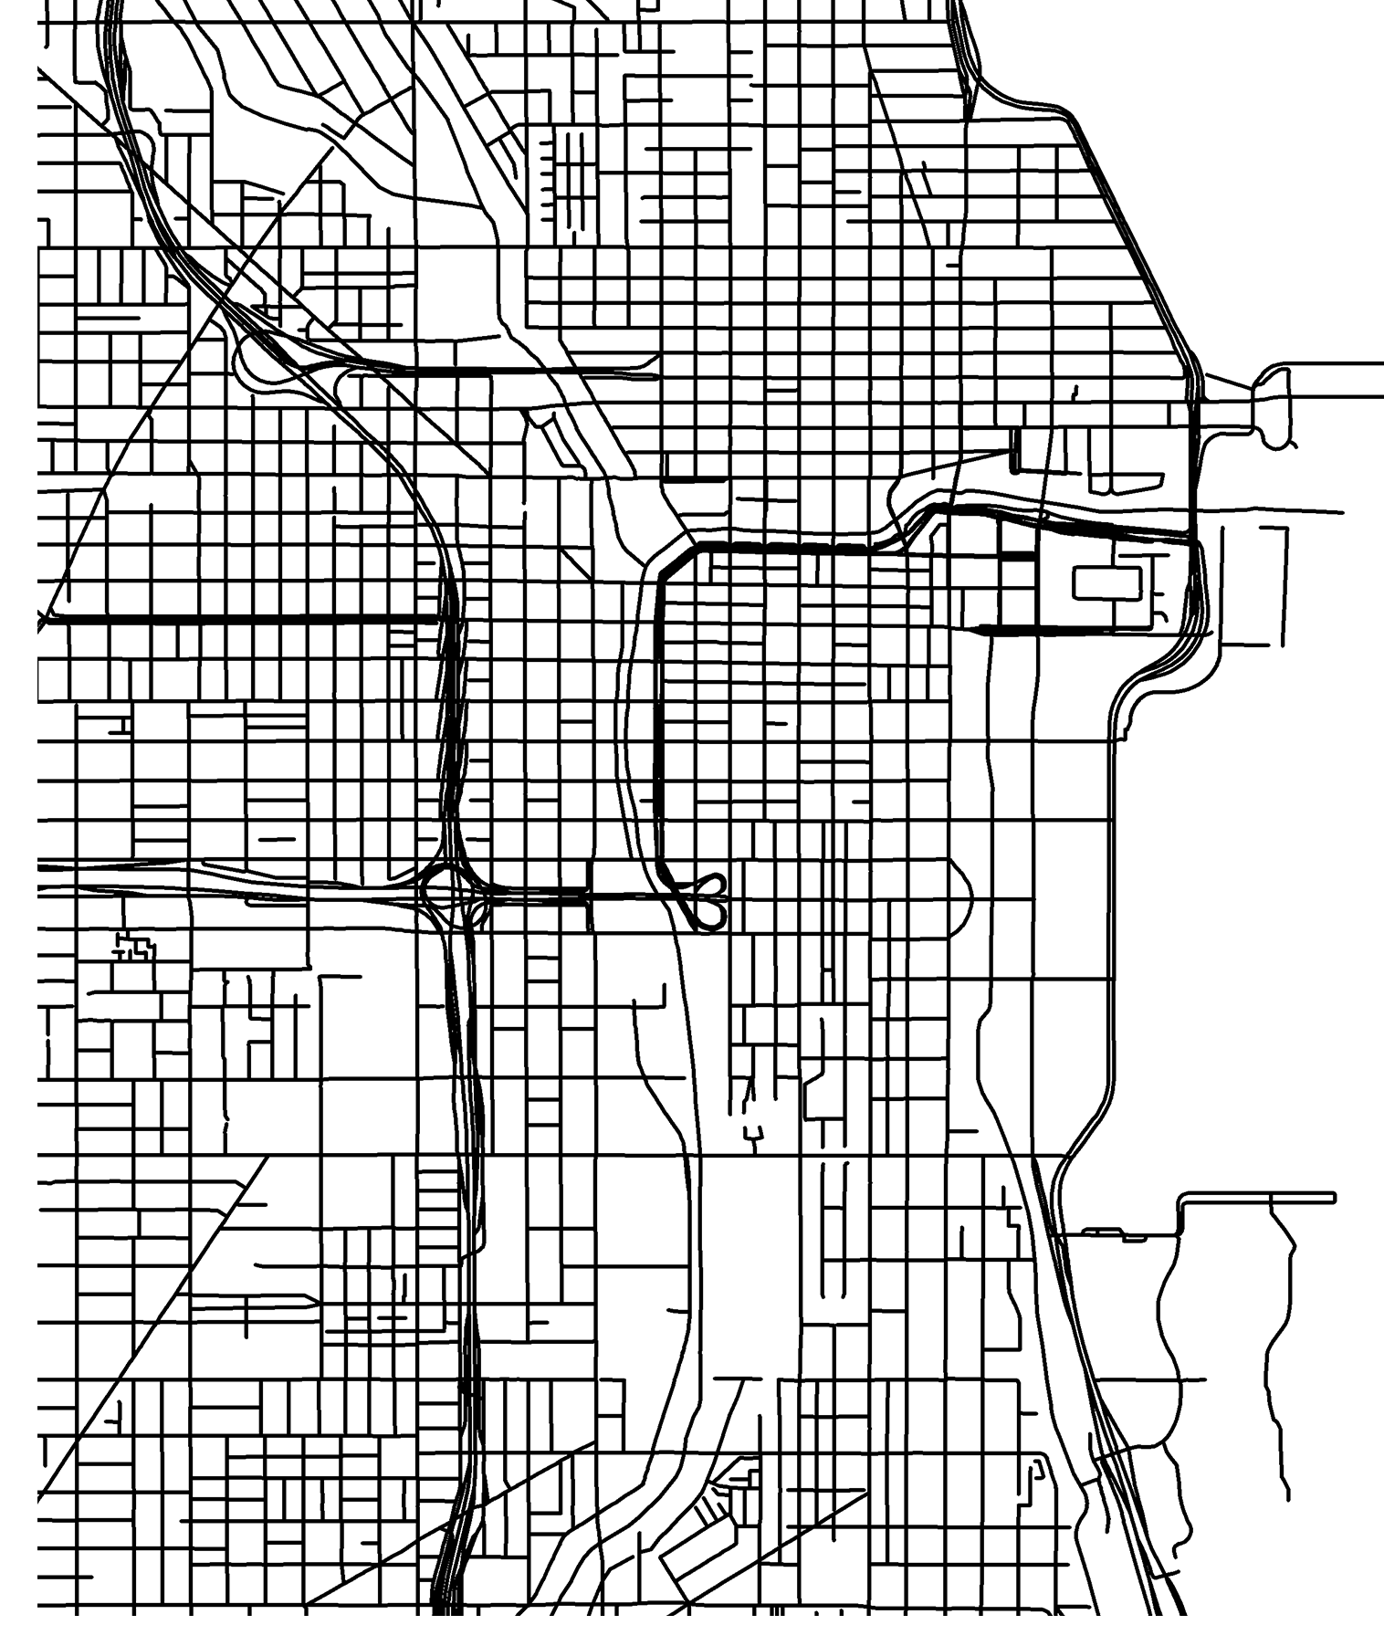
Smart Cities
Felipe, Katy, Sandra

Slide 2

Motivation and Summary
In Chicago, is there a correlation between housing price, income, or poverty and the walkability of an area?
Define the core message or hypothesis of your project.
Describe the questions you asked, and why you asked them
Describe whether you were able to answer these questions to your satisfaction, and briefly summarize your findings

Slide 3

Question & Data
Elaborate on the questions you asked, describing what kinds of data you needed to answer them, and where you found it

Slide 4

Data Cleanup & Exploration
Describe the exploration and cleanup process
Discuss insights you had while exploring the data that you didn't anticipate
Discuss any problems that arose after exploring the data, and how you resolved them
Present and discuss interesting figures developed during exploration, ideally with the help of Jupyter Notebook

Slide 5
Data Cleanup & Exploration
Census
Walkscore
Zillow
Cook County

Slide 6

Data Analysis
The further outside the city you get the lower the walkscore and the higher the income
Discuss the steps you took to analyze the data and answer each question you asked in your proposal
Present and discuss interesting figures developed during analysis, ideally with the help of Jupyter Notebook

Slide 7

Discussion
Discuss your findings. Did you find what you expected to find? If not, why not? What inferences or general conclusions can you draw from your analysis?

Slide 8
Discussion
Demographics/housing stock
Scatters
Maps
Bars?

Slide 9
Discussion
Income
Scatters
Maps
Bars?

Slide 10
Discussion
House cost
Scatters
Maps
Bars?

Slide 11
Discussion
Unemployment/poverty
Scatters
Maps
Bars?

Slide 12

Post Mortem
There is a lot of data- especially in the census
Discuss any difficulties that arose, and how you dealt with them
Discuss any additional questions that came up, but which you didn't have time to answer: What would you research next, if you had two more weeks?

Slide 13
Post Mortem
Limitations of APIs (initial, Zillow)
Look at data overtime
Discuss any additional questions that came up, but which you didn't have time to answer: What would you research next, if you had two more weeks?

Slide 14

Questions?

Slide 15
requirements
Be at least 8-10 min. long
Describe the core message or hypothesis for your project.
Describe the questions you and your group found interesting, and what motivated you to answer them
Summarize where and how you found the data you used to answer these questions
Describe the data exploration and cleanup process (accompanied by your Jupyter Notebook)
Describe the analysis process (accompanied by your Jupyter Notebook) Summarize your conclusions. This should include a numerical summary (i.e., what data did your analysis yield), as well as visualizations of that summary (plots of the final analysis data)
Discuss the implications of your findings. This is where you get to have an open-ended discussion about what your findings "mean".
Tell a good story! Storytelling through data analysis is no different than in literature. Find your narrative and use your analysis and visualization skills to highlight conflict and resolution in your data

